Slide 1
Chapter 2
Network Models

Slide 2
The main responsibility of computer network is to enable two processes, which are not in same computer, to communicate.
So in computer networks, we are providing both H/W and S/W functionalities to these processes.
There are nearly around 70+ such functions. Some are mandatory and some are optional functionality.
Hence, we need to think about, how to implement them, where to implement them. What are the sets of functionalities which are closely related to each other. What are the sets of functionalities which are not closely related to each other.

Slide 3
So depending upon all these functionalities and their grouping, we have some reference models.
ISO/OSI Reference Model
TCP/IP Reference Model
ATM
X.25
IEEE (LAN Technologies)

Slide 4
The ISO/OSI Model
ISO/OSI – International Standard Organization/ Open System Inter-connection.
Now when we have so many functions to implement, it is better to put all the closely related functions and form their group.
So that it is easy for us to implement them.

Slide 5
2-1 LAYERED TASKS
We use the concept of layers in our daily life. As an example, let us consider two friends who communicate through postal mail. The process of sending a letter to a friend would be complex if there were no services available from the post office.
Topics discussed in this section:
Sender, Receiver, and Carrier Hierarchy

Slide 6
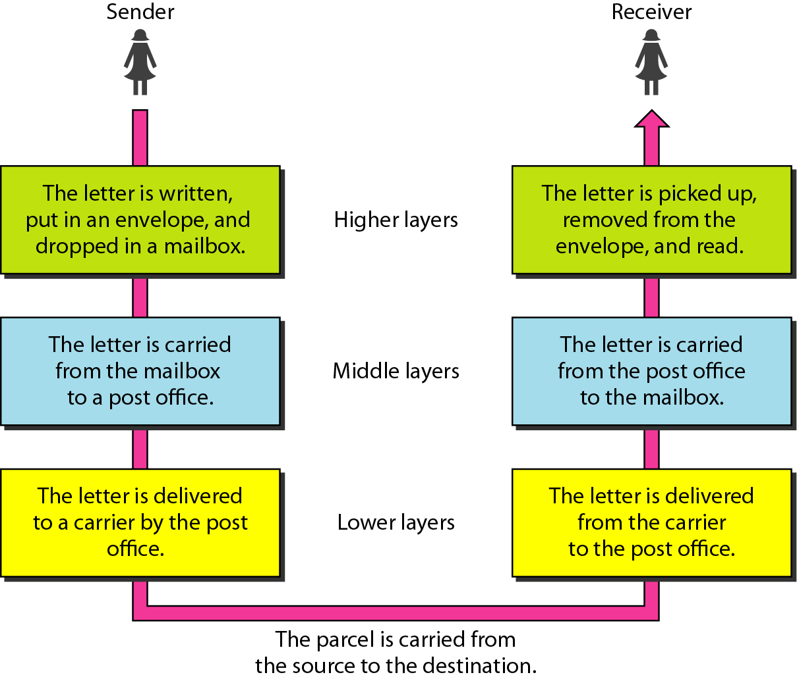
Figure 2.1 Tasks involved in sending a letter

Slide 7
2-2 THE OSI MODEL
Established in 1947, the International Standards Organization (ISO) is a multinational body dedicated to worldwide agreement on international standards. An ISO standard that covers all aspects of network communications is the Open Systems Interconnection (OSI) model. It was first introduced in the late 1970s.
Topics discussed in this section:
Layered Architecture Peer-to-Peer Processes
Encapsulation

Slide 8

Note
ISO is the organization. OSI is the model.

Slide 9
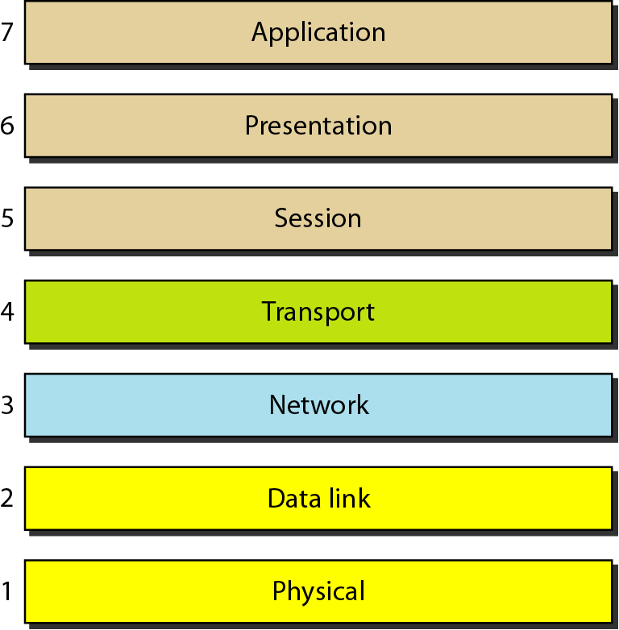
Figure 2.2 Seven layers of the OSI model

Slide 10
Advantages of classifying into layers:
-- Divide & Conquer Technique
-- Encapsulation
-- Abstraction
-- Testing

Slide 11
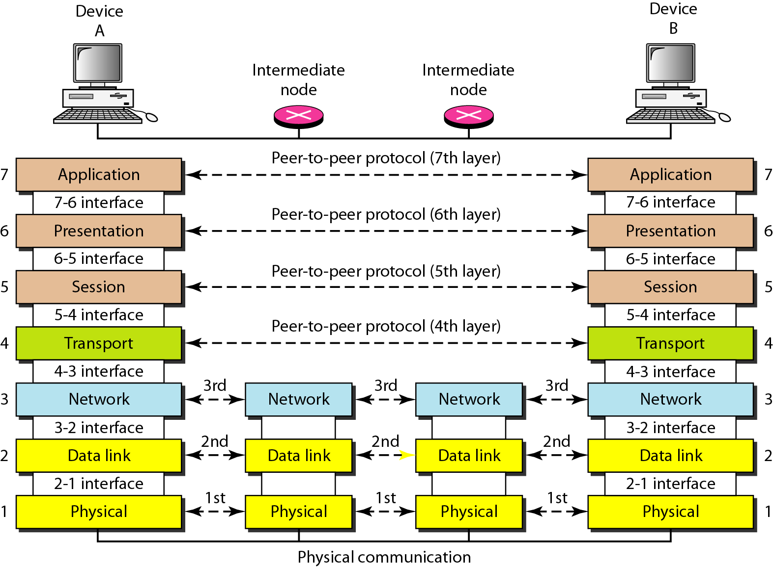
Figure 2.3 The interaction between layers in the OSI model

Slide 12
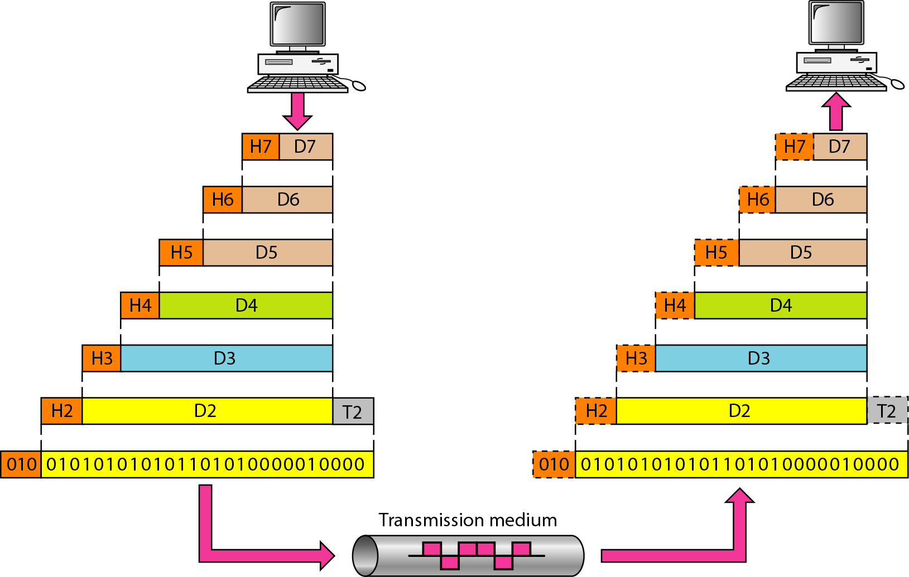
Figure 2.4 An exchange using the OSI model

Slide 13
2-3 LAYERS IN THE OSI MODEL
In this section we briefly describe the functions of each layer in the OSI model.
Topics discussed in this section:
Physical Layer Data Link Layer
Network Layer
Transport Layer
Session Layer
Presentation Layer
Application Layer

Slide 14
Functions of Physical Layer (Layer-1)
The physical layer coordinates the functions required to carry a bit stream over a physical medium.
Physical Layer deals with
Electrical characteristics
Mechanical characteristics
Functional characteristics
Procedural characteristics
of a physical link.
If physical link is of type copper – That means if you are sending your message over copper wire, then message has to be converted into electrical signal. Or if it is of type optical fibre, then the message has to be converted into light. Or if available link is wireless then the message has to be converted into electromagnetic waves.
So depending on what is the type of link is available; the signals are converted accordingly.

Slide 15
Functional & Procedural characteristics means: which type of transmission modes we can use.
Physical Layer also deals with Network topologies:- logically how devices are connected.
Physical Layer also deals with encoding and representation of bits:- given 1’s and 0’s data, how are you going to convert them into waves or electrical signal and send them.
We have two ways to encode the bits:
Manchester Encoding
Differential Manchester Encoding

Slide 16
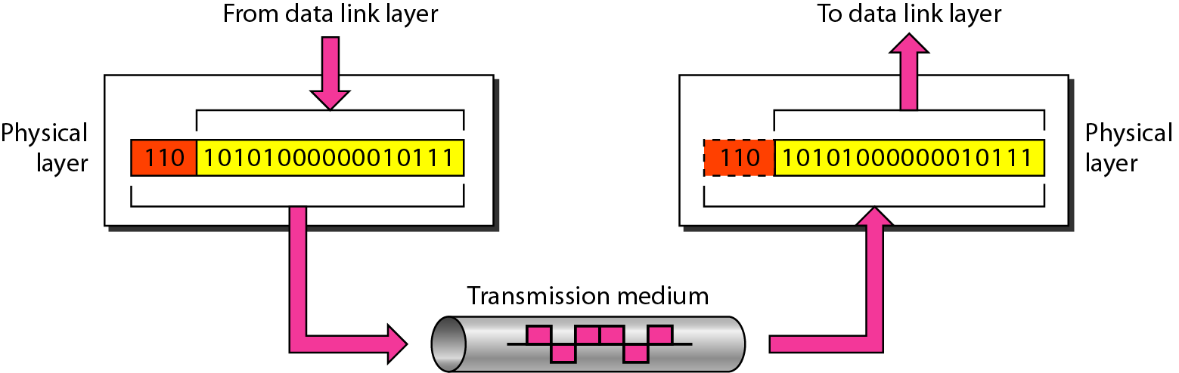
Figure 2.5 Physical layer

Slide 17
Functions of Data Link Layer (DLL) (Layer-2)
The data link layer is responsible for moving frames from one hop (node) to the next.
The responsibilities of the data link layer include the following:
Framing
Physical addressing
Flow control
Error control
Access control

Slide 18
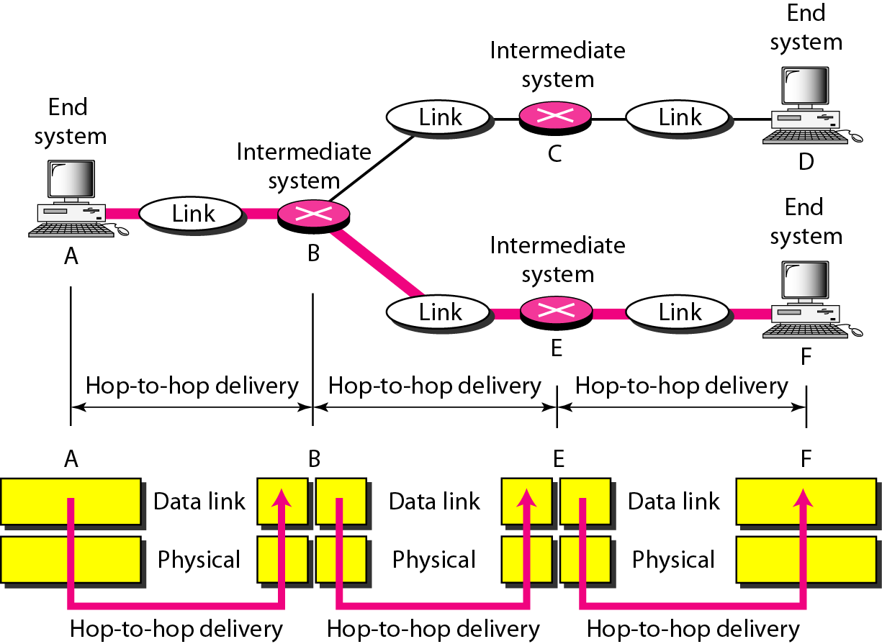
Figure 2.7 Hop-to-hop delivery

Slide 19
Functions of Network Layer (Layer-3)
The network layer is responsible for the source-to-destination delivery of a packet, across multiple networks. (Host-to-host communication)
However, the data link layer oversees the delivery of the packet between two systems on the same network.
The responsibilities of the network layer includes the following:
Logical Addressing
Routing/Switching
Fragmentation

Slide 20
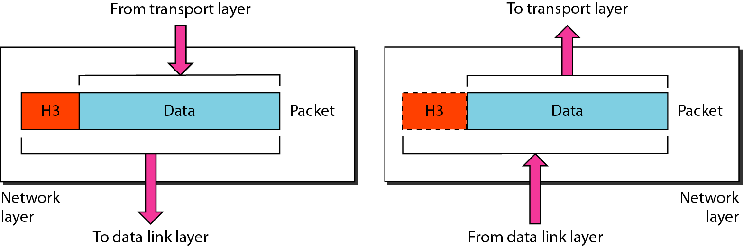
Figure 2.8 Network layer

Slide 21
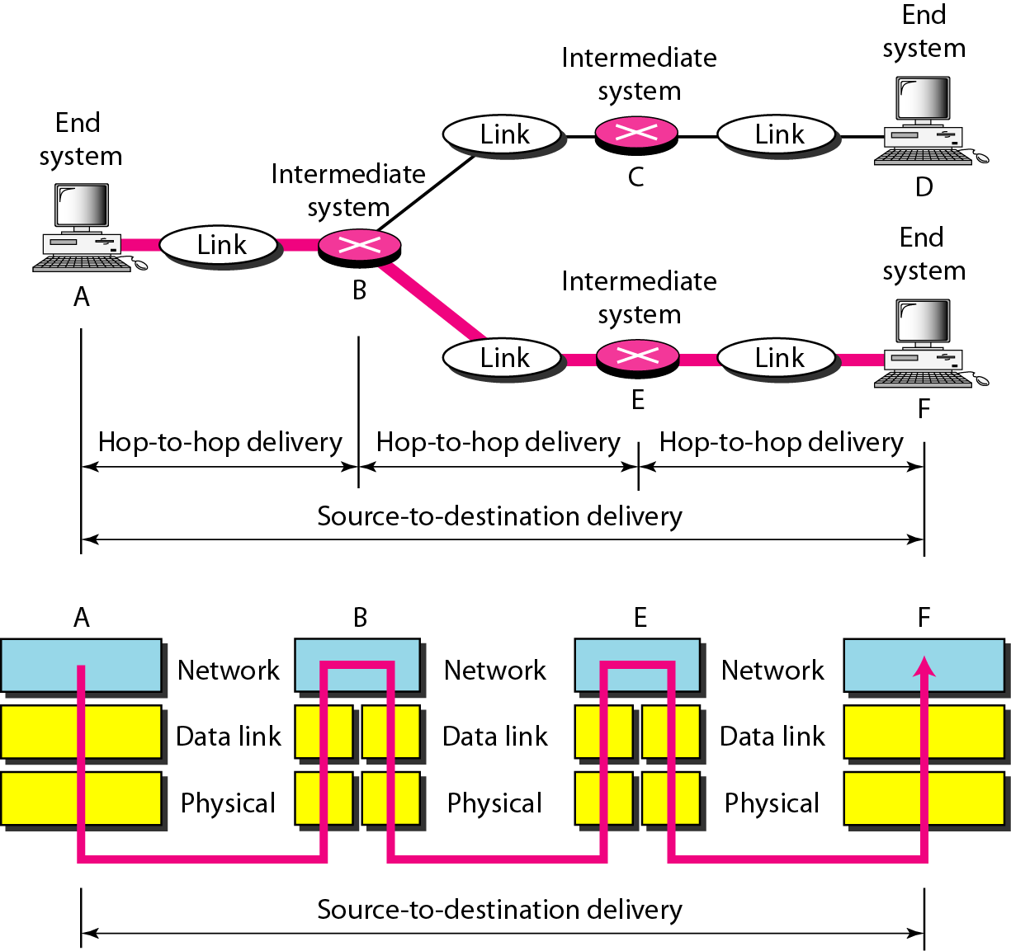
Figure 2.9 Source-to-destination delivery

Slide 22
Functions of Transport Layer (Layer-4)
The transport layer is responsible for process-to-process delivery of the entire message.
Whereas the network layer oversees source-to-destination delivery of individual packets, it does not recognize any relationship between those packets.
Network layer treats each packet as independent entity.
The transport layer, on the other hand, ensures that the whole message arrives intact and in order.
The responsibilities of the transport layer includes the following:
Service-point addressing
Segmentation and Reassembly
Error and Flow control

Slide 23
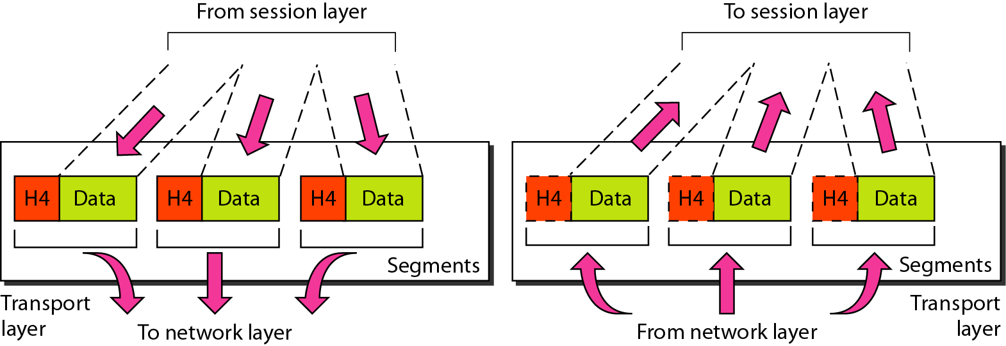
Figure 2.10 Transport layer

Slide 24
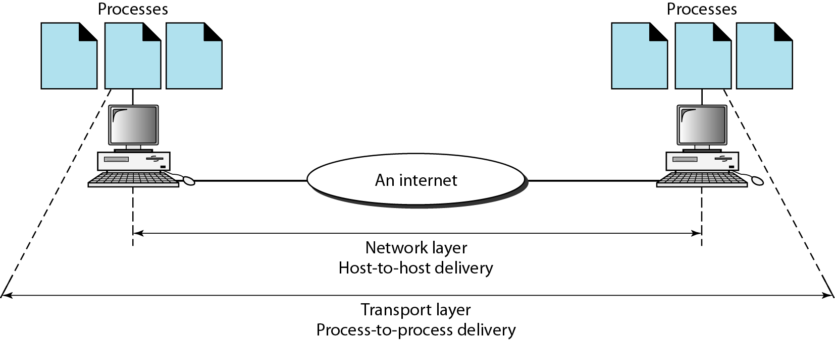
Figure 2.11 Reliable process-to-process delivery of a message

Slide 25
Functions of Session Layer (Layer-5)
The session layer is the network dialog controller.
It establishes, maintains, and synchronizes the interaction among communicating systems.
The responsibilities of the session layer includes the following:
Dialog control
Synchronization

Slide 26
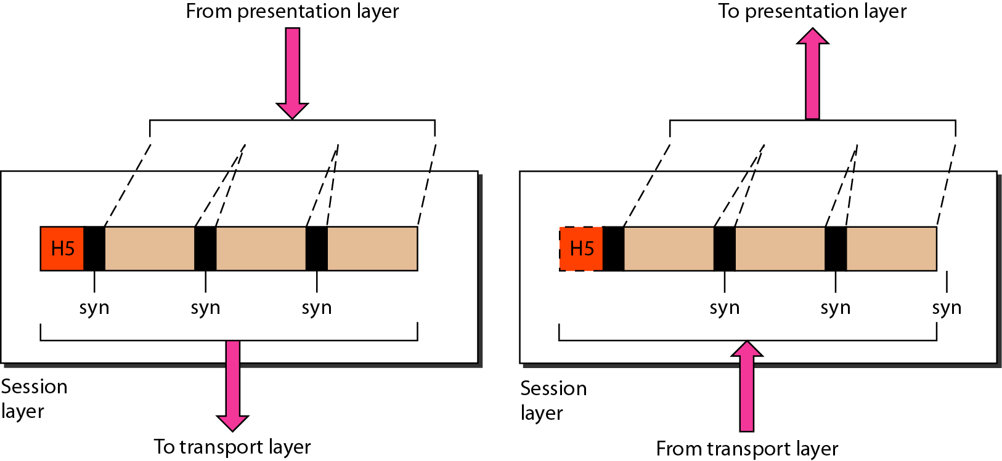
Figure 2.12 Session layer

Slide 27
Note
The session layer is responsible for dialog control and synchronization.

Slide 28
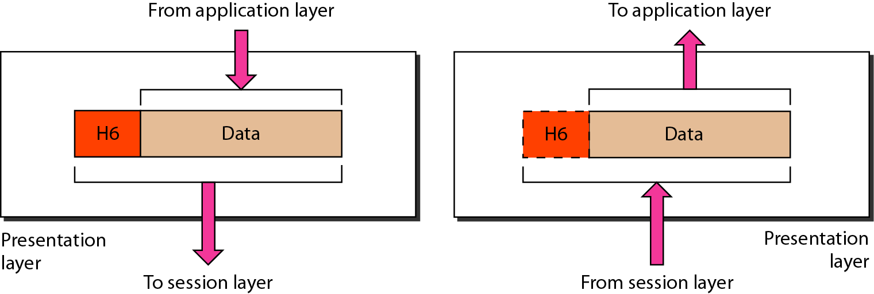
Figure 2.13 Presentation layer

Slide 29
Functions of Presentation Layer (Layer-6)
The presentation layer is concerned with the syntax and semantics of the information exchanged between two systems.
The responsibilities of the presentation layer includes the following:
Translation
Encryption
Decryption
Compression

Slide 30
Note
The presentation layer is responsible for translation, compression, and encryption.

Slide 31
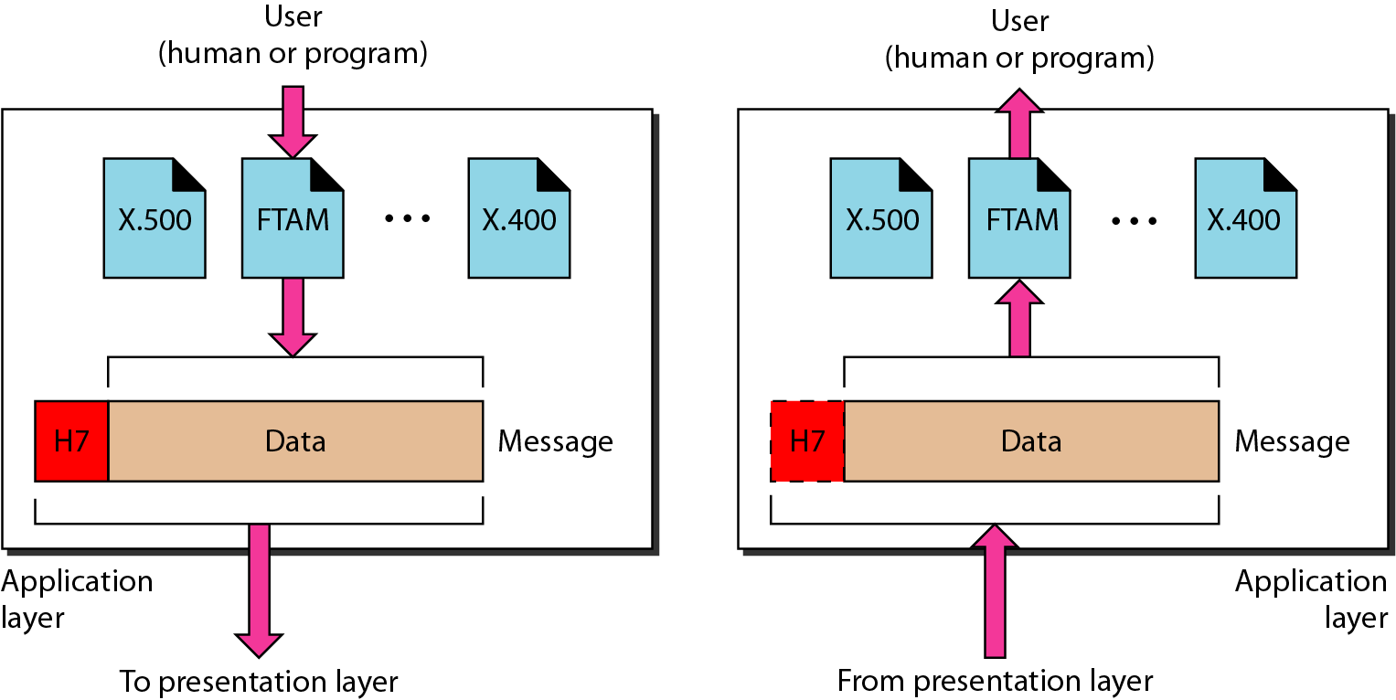
Figure 2.14 Application layer

Slide 32
Functions of Application Layer (Layer-7)
The application layer enables the user, whether human or software, to access the network.
It provides user interfaces and support for services such as electronic mail, remote file access and transfer.

Slide 33
Note
The application layer is responsible for providing services to the user.

Slide 34
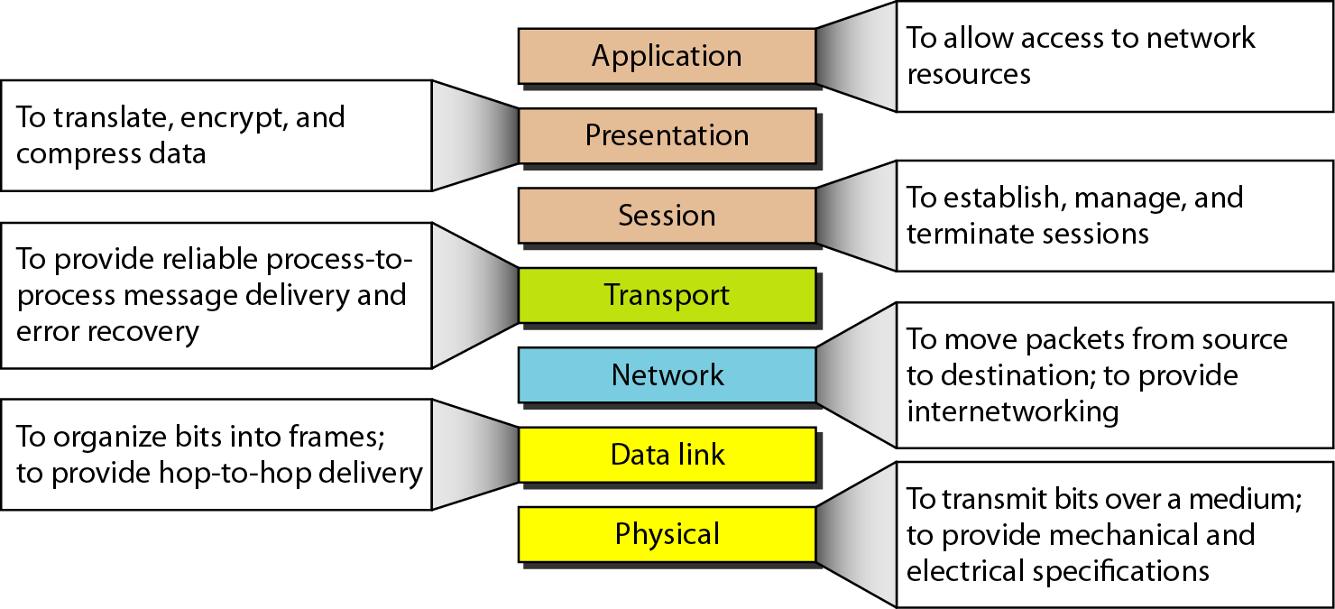
Figure 2.15 Summary of layers

Slide 35
2-4 TCP/IP PROTOCOL SUITE
The layers in the TCP/IP protocol suite do not exactly match those in the OSI model. The original TCP/IP protocol suite was defined as having four layers: host-to-network, internet, transport, and application. However, when TCP/IP is compared to OSI, we can say that the TCP/IP protocol suite is made of five layers: physical, data link, network, transport, and application.
Topics discussed in this section:
Physical and Data Link Layers Network Layer Transport Layer
Application Layer

Slide 36
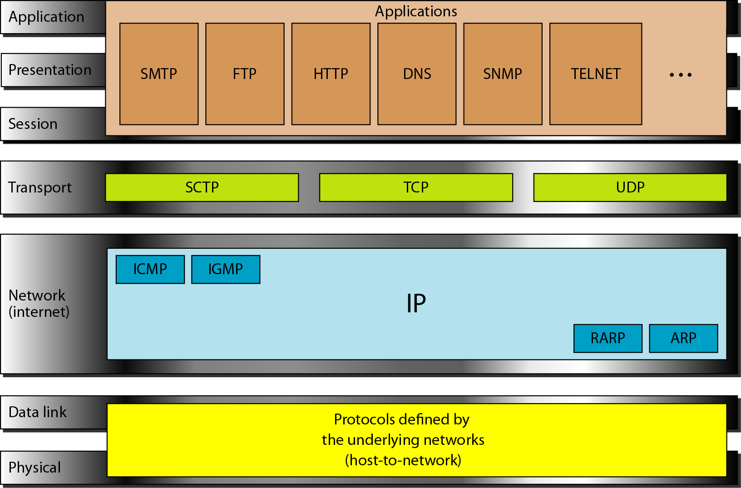
Figure 2.16 TCP/IP and OSI model

Slide 37
2-5 ADDRESSING
Four levels of addresses are used in an internet employing the TCP/IP protocols: physical, logical, port, and specific.
Topics discussed in this section:
Physical Addresses Logical Addresses Port Addresses Specific Addresses

Slide 38
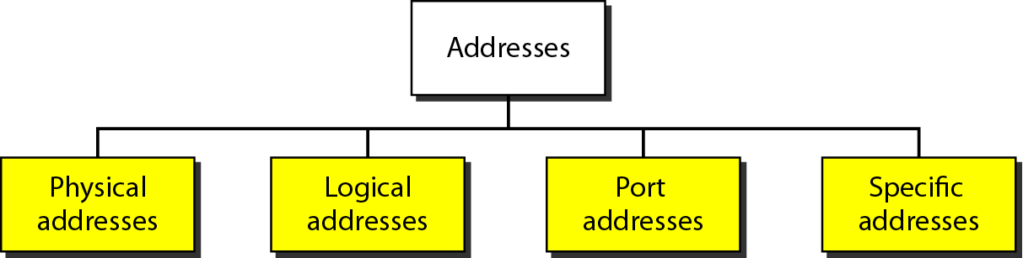
Figure 2.17 Addresses in TCP/IP
Some applications have user-friendly addresses that are designed for that specific address.
Examples include the e-mail address and the Universal Resource Locator (URL).
The e-mail address defines the recipient of an e-mail;
The URL is used to find a document on the World Wide Web.
These addresses, however, get changed to the corresponding port and logical addresses by the sending computer.

Slide 39
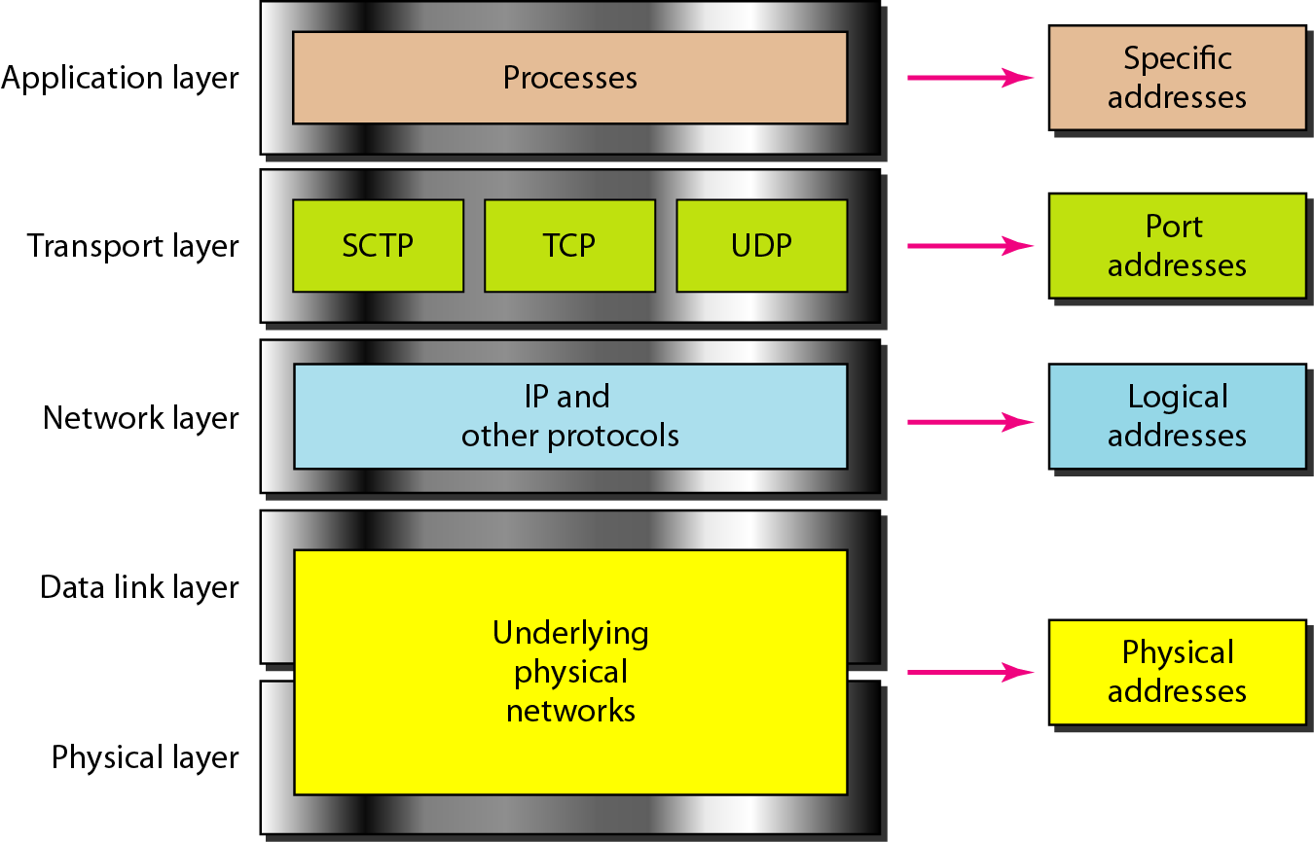
Figure 2.18 Relationship of layers and addresses in TCP/IP

Slide 40
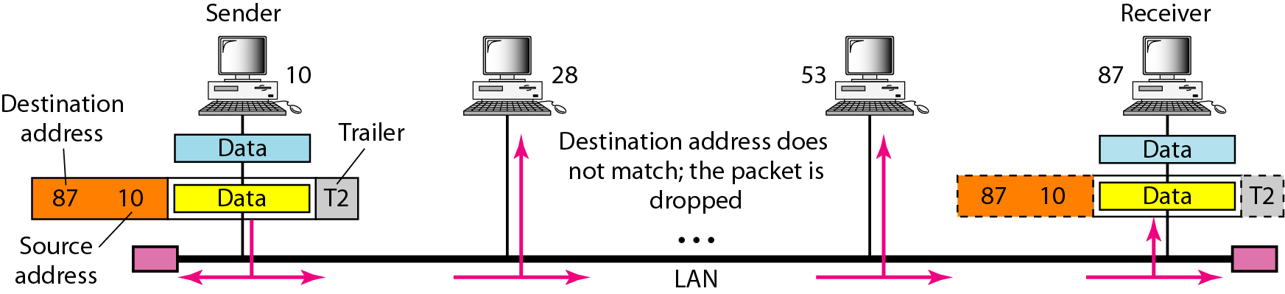
Example 2.1
In Figure 2.19 a node with physical address 10 sends a frame to a node with physical address 87. The two nodes are connected by a link (bus topology LAN). As the figure shows, the computer with physical address 10 is the sender, and the computer with physical address 87 is the receiver.

Slide 41
Figure 2.19 Physical addresses

Slide 42
Example 2.2
Most local-area networks use a 48-bit (6-byte) physical address written as 12 hexadecimal digits; every byte (2 hexadecimal digits) is separated by a colon, as shown below:
07:01:02:01:2C:4B
A 6-byte (12 hexadecimal digits) physical address.

Slide 43
Example 2.3
Figure 2.20 shows a part of an internet with two routers connecting three LANs. Each device (computer or router) has a pair of addresses (logical and physical) for each connection. In this case, each computer is connected to only one link and therefore has only one pair of addresses. Each router, however, is connected to three networks (only two are shown in the figure). So each router has three pairs of addresses, one for each connection.

Slide 44
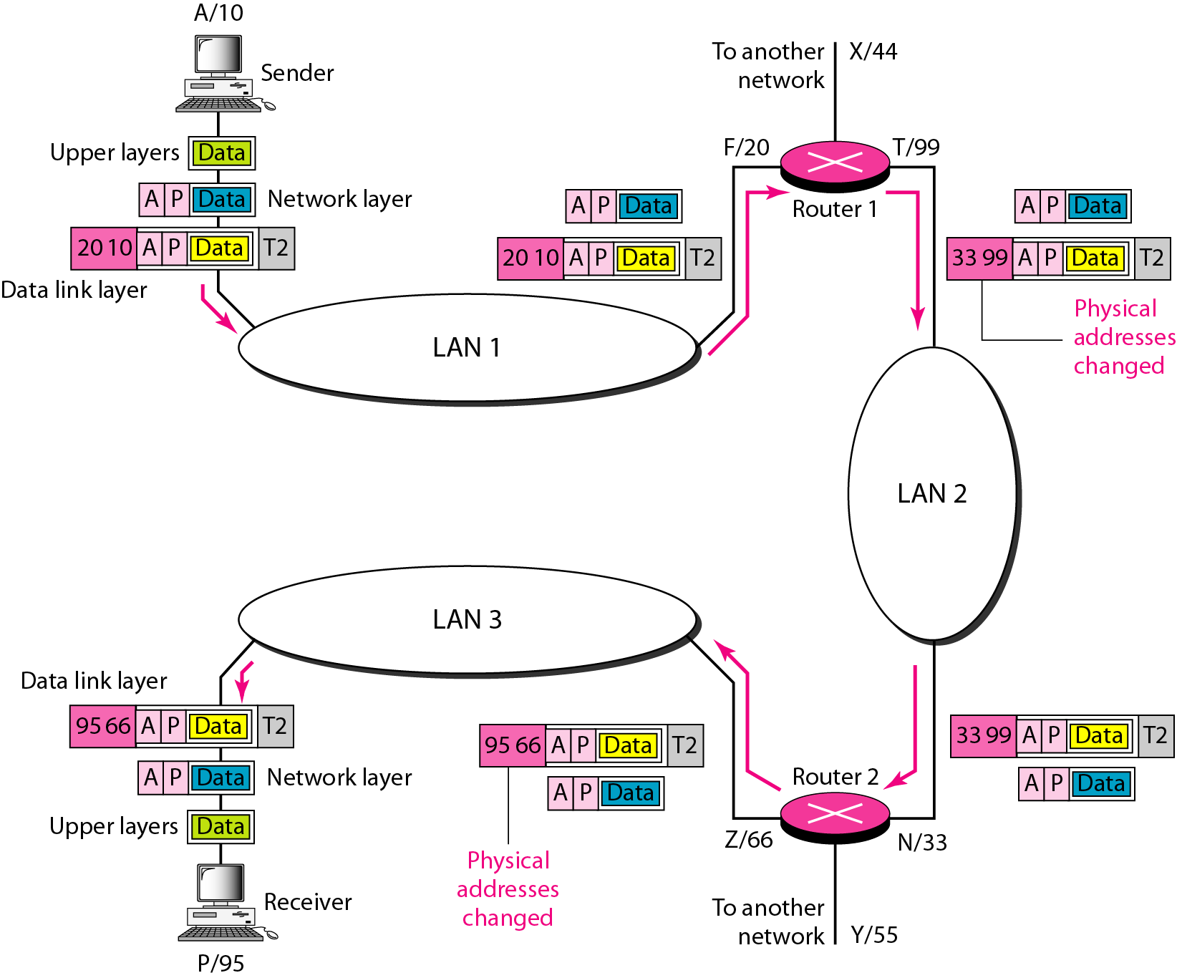
Figure 2.20 IP addresses

Slide 45
Example 2.4
Figure 2.21 shows two computers communicating via the Internet. The sending computer is running three processes at this time with port addresses a, b, and c. The receiving computer is running two processes at this time with port addresses j and k. Process a in the sending computer needs to communicate with process j in the receiving computer. Note that although physical addresses change from hop to hop, logical and port addresses remain the same from the source to destination.

Slide 46
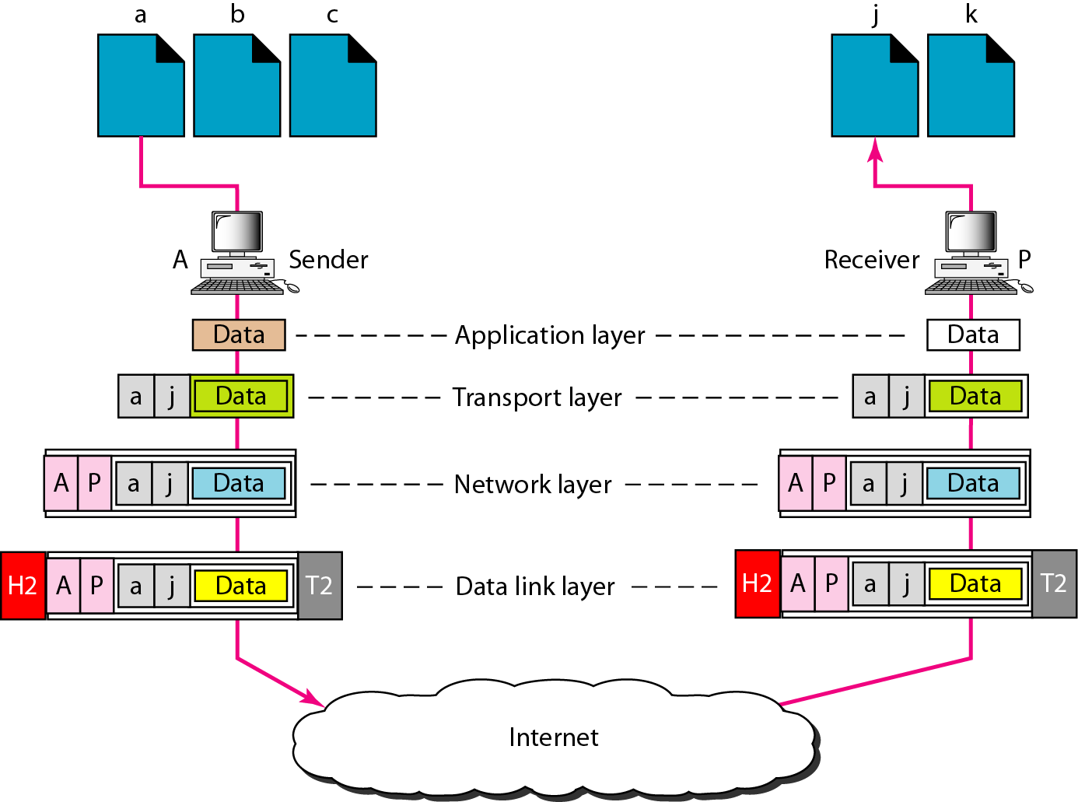
Figure 2.21 Port addresses

Slide 47
Note
The physical addresses will change from hop to hop,
but the logical addresses usually remain the same.

Slide 48
Example 2.5
A port address is a 16-bit address represented by one decimal number as shown.
753
A 16-bit port address represented as one single number.

